Slide 1

WNE UW
Topic 3
Consumer choice -> demand
Notes:
1

Slide 2
Escape from the Arrow-Debreu world
In the Arrow-Debreu of General Equilibrium Model, the is incredible transition from the theory microscale to the theory of macroscale. The model behaviour of the economic atoms is used to describe the whole economy. Even in physics, the transition from micro to macro scale is no so smooth. But there is no free lunch. In general economic models, we have to set a lot of assumptions (axioms) to do the transition. The is a mixture of behavioural assumptions and only technical assumptions which crate the abstract creature of Homo Economicus. There is a lot of assumptions about the environment in which HE operates. At the lectures, we will discuss validity of the assumptions for consumer behaviour.

Slide 3
Report 3 (3 parts)
The homework consists of three parts:
Summary of an interesting study of demand.
Interpretation of the patterns, errors and strange behaviours - your analysis of the demand Shiny app.
A short reflection on the survey and data ethics.
You can write a forum post that focuses on only one of these topics, or you can combine two or even all three in a single, longer post – that choice is up to you.

Slide 4
Report 3 (the first part)
In the first part of your new assignment (lecture report), please find and post a summary of an interesting study that could complement today’s class. Your post should be a well-considered, documented statement, where you act as a “research detective” focused on demand in different environments. Factors affecting demand characteristics extend beyond economics alone, including geography, culture, religion, etc.
I’m particularly interested in studies that estimate various elasticities (price, income, cross-elasticity) for different products, even unusual or abstract ones.
Feel free to use AI for research assistance; however, this requires careful prompt crafting. Remember, AI responses are not always accurate – double-check sources, especially if anything seems questionable.

Slide 5
Report 3 (the second topic)
The second part of the homework is an analysis of the results from our WTP–WTA experiment.
The report is available as an interactive Shiny app at:
[https://microeconomics.shinyapps.io/demand_0_92/].
Please explore the app carefully, go through all tabs and plots, and describe in your own words what you see: regularities and relationships in the data, but also errors, inconsistencies, outliers and strange or unexpected behaviour of models.

Slide 6
Report 3 (the third topic)
The third part is a short reflection on the survey itself and on data ethics. Some questions in the questionnaire – for example about your monthly disposable income – were intentionally chosen to be slightly uncomfortable.
I would like you to reflect on what exactly felt intrusive and why, and to compare this classroom situation with real-world data collection, where social media, smartphones and many online services continuously record information about you.
From this perspective, how do you see the role and responsibility of data science?

Slide 7
The maximization problem
The consumer choice is brought to maximization problem with constraints.
Max U(X₁, X₂,…, X_{n})
p₁x₁ + p₂x₂ +…+ p_{n}x_{n} = M
The general solution to this problem provides the demand functions that households report to the market.

Slide 8
Marshallian Demand
Marshallian Demand (obtained from the primal optimization problem - Hicksian demand is derived from the dual problem) is the most frequently analyzed form of the demand function. Understanding the terminology (slang) associated with this function and its properties is essential.
We will compare the general properties of the demand function derived from optimization models with the Cobb-Douglas utility function. Although the linear function is more commonly used in textbooks, we will cover it in detail during our lecture on pricing strategies.
Required Tool: Elasticity - the percentage change in demand caused by a 1% change in the relevant variable.

Slide 9
Change of price
p1
The ceteris paribus principle – we change only one factor, the price, and observe how the quantity purchased changes. The accepted convention is to present the inverse demand function p1 = f(x1) on graphs.
x1
X1’
X1’’
X1’’’

Slide 10
Law of demand
x1 = f(p1, M, p2, …
p1
(-) law of demand states that, all else being fixed (ceteris paribus), as the price of a good or service increases, the quantity demanded by consumers decreases, and vice versa→ price increases demand decreases, but there are exceptions:
Giffen good - theoretical creature, there are people who claim that it was found in the wild. According to the theory no change in preferences (will not be discussed)
Veblen good - change in preferences due to snob effect or network efect (will be discussed)
We want to know other characteristics of this relationship
X1’

Slide 11
Price elasticity
Extremes:
C
To understand the basic characteristic of demand sensitivity to price changes (price elasticity), we need to start with the extremes. Demand A is perfectly inelastic, meaning price has no effect on the quantity purchased [e.g., medicines to some extent]. Demand B is completely price-dependent and is perfectly elastic. Up to a certain price, nothing is purchased; at a specific price, any quantity will be bought [an artificial example might be a grain silo: grain prices are fixed, a small farmer approaches, and we buy everything from him at the market price].
At first glance, we might say that demand D is more elastic, more sensitive to price changes than demand C, based on a comparison with extremes. However, we need to be cautious; elasticity depends on the prices at which we measure it. It may turn out that the price elasticity of demand D at a high price is lower than that of demand C at a low price.
Perfectly Inelastic Demand
A
p1
p1
x1
x1
Perfectly Elastic Demand
D
B
p1
p1
x1
x1

Slide 12
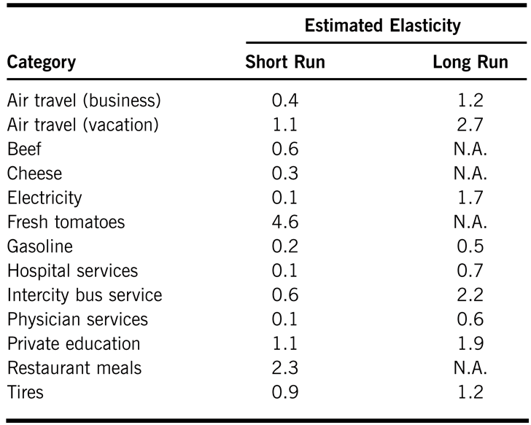
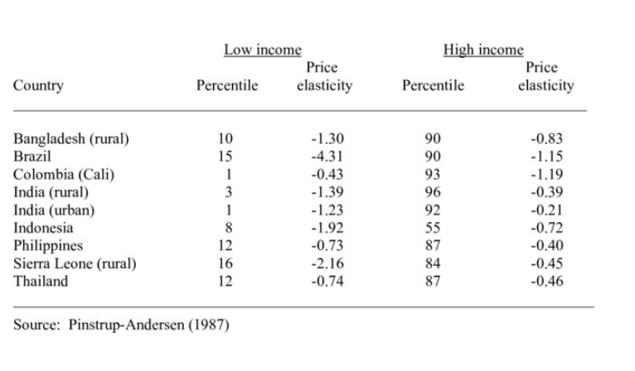
Price elasticity
We should estimate or calculate elasticities or use research from others. A simple interpretation [remember to ignore the minus sign, and when discussing price elasticity, refer to absolute values]:
E_{p}>1: demand at a given price is elastic.
E_{p}<1: demand at a given price is inelastic.
Price elasticity of demand can depend on many factors. Differences may arise due to time (consumers adjust less in the short term). It also depends on geographic location, culture, etc. For your assignment, you can showcase and interpret such comparisons. Surprisingly, it is not easy to find that type of reserach.
Price elasticities of demand for rice among low-income and high-income groups, selected countries

Slide 13
Change of income
x1
The ceteris paribus principle – we change only one factor, the income, and observe how the quantity purchased changes.
The Engel curve shows the relationship between a consumer's income and the quantity of a good they demand.
M
X1’
X1’’
X1’’’

Slide 14
Income elasticity / taxonomy
Types of Goods Based on Income Elasticity:
x1 = f(p1, M, p2, …
(-) Inferior goods for which demand decreases as income rises. For inferior goods E_{income}< 0
[ Margarine E_{income} ​= −0.20 ]
[ Public Transportation E_{income}= -0.36
(+) Normal good - A good for which demand increases as income rises. For normal goods E_{Income}>1
Superior (luxory) have a high income elasticity, meaning demand rises more than proportionally with income increases E_{income} > 1
[Automobiles E_{income} =2.46 ]
[Books E_{income} =1.44]
[Restaurant Meals E_{income} =1.40]
Necessity goods have an income elasticity between 0 and 1, meaning demand rises but at a slower rate than income 0 < E_{income}<1.
[Tobacco E_{income} ​= 0.64

Slide 15
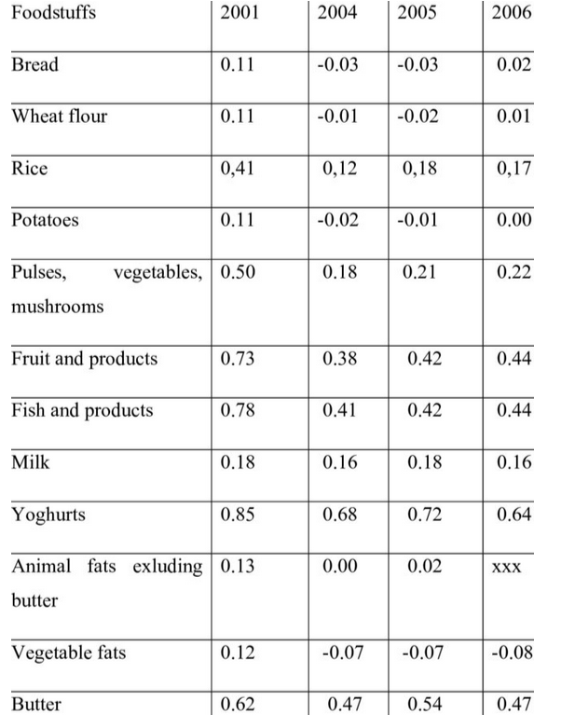
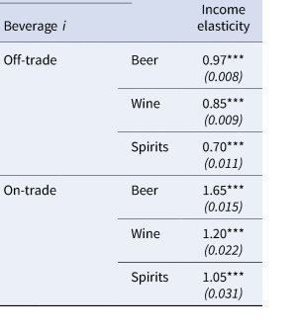
Income elasticity
Income elasticity can depend on many factors. …
Differences may arise due …
For your assignment, you can showcase and interpret such comparisons.
….. Surprisingly, it is not easy to find that type of reserach.

Slide 16

Cross-price elasticity / taxonomy
(-) x1 and x2 are complementary goods (E_{cross}<0 ). When the cross-price elasticity is negative, an increase in the price of one good (x2) leads to a decrease in the demand for the other good (x1).
This occurs because the goods are used together. When one becomes more expensive, people tend to reduce consumption of both goods.
x1 = f(p1, M, p2, …
(+) x1 and x2 are substitutes goods (E_{cross}> 0) When the cross-price elasticity is positive, an increase in the price of one good (x2) leads to an increase in the demand for the other good (x1).
This relationship occurs because consumers see the goods as alternatives. When one becomes more expensive, they switch to the other.
(0) x1 and x2 independent goods (E_{cross}> 0)
When the cross-price elasticity is zero, it indicates that the price change of one good has no impact on the demand for another good. They are unrelated in terms of consumption.
The cross-price elasticity of demand measures the responsiveness of the quantity demanded for one good when the price of another good changes.

Slide 17
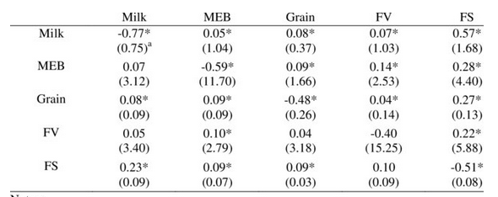
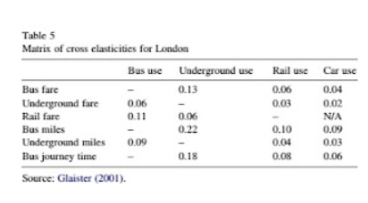
Cross-price elasticity
Cross-price elasticity can depend on many factors. …
Differences may arise due …
For your assignment, you can showcase and interpret such comparisons.
….. Surprisingly, it is not easy to find that type of reserach.

Slide 18
Cross-price elasticity / taxonomy
x1 = f(p1, M, p2, …
p1
(?) What is the influence of other factors? It is very difficult to find research directly related to the demand function understood in this way.
In textbooks, the demand curve is typically shifted parallel due to unspecified factors.
(+)
(-)
x1

Slide 19
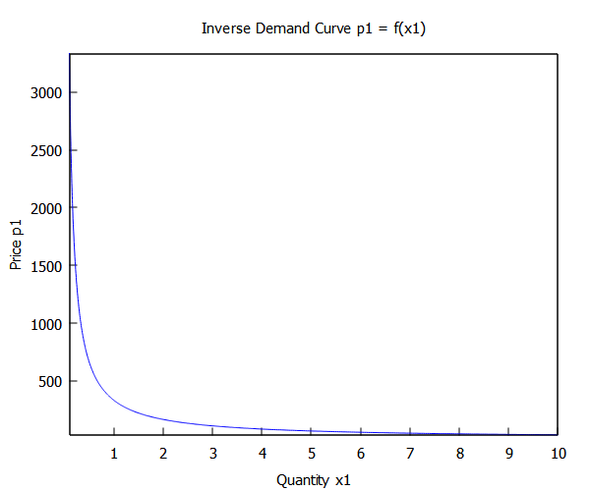
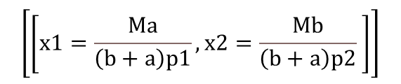
Properties of the demand function
kill(all); /* Clear all previous definitions and variables */
/* Load the draw package (only necessary if plotting is required) */
load(draw);
/* Assume positive values for variables and parameters */
assume(
x1 > 0, x2 > 0, /* Quantities of goods x1, x2 */
p1 > 0, p2 > 0, /* Prices of goods p1, p2 */
α > 0, α < 1, /* Preference parameter α for x1 */
β > 0, β < 1, /* Preference parameter β for x2 */
M > 0 /* Consumer's income */
);
/* Declare constants to ensure they are not treated as variables in Maxima */
declare(α, constant);
declare(β, constant);
/* Define the utility function U (Cobb-Douglas form) */
U: (x1^α) * (x2^β);
/* Define the Lagrangian function L with the budget constraint */
L: U + λ * (M - p1 * x1 - p2 * x2);
/* Compute the first-order conditions by taking partial derivatives */
eq1: diff(L, x1) = 0; /* Partial derivative with respect to x1 */
eq2: diff(L, x2) = 0; /* Partial derivative with respect to x2 */
eq3: diff(L, λ) = 0; /* Partial derivative with respect to λ (the budget constraint) */
/* Solve the system of equations for x1, x2, and λ */
solutions: solve([eq1, eq2, eq3], [x1, x2, λ]);
/* Extract the first solution from the list of solutions */
FOC: solutions[1]; /* First-Order Conditions */
/* Assign the solutions to variables for x1, x2, and λ */
_x1: rhs(FOC[1]); /* Optimal quantity of good x1 */
_x2: rhs(FOC[2]); /* Optimal quantity of good x2 */
_λ: rhs(FOC[3]); /* Value of the Lagrange multiplier λ */
/* Solve for the inverse demand function for p1 */
INV_d: solve([x1=_x1], [p1]);
p1: rhs(INV_d[1]); /* Extract the right-hand side of the solution */
/* Set values for parameters to be used in plotting */
M: 1000;
α: 0.3; /* Preference parameter α for x1 */
β: 0.6; /* Preference parameter β for x2 */
/* Plot the inverse demand curve for p1 as a function of x1 */
draw2d(
title = "Inverse Demand Curve p1 = f(x1)",
xlabel = "Quantity x1",
ylabel = "Price p1",
explicit(p1, x1, 0.1, 10), /* Plot inverse demand as a function of x1 */
color = green,
line_width = 2);
$$\left[\left[x1=\frac{M⁢a}{\left(b+a\right)⁢p1},x2=\frac{M⁢b}{\left(b+a\right)⁢p2} \right]\right]$$
Properties of the demand function derived from optimization models with the Cobb-Douglas utility function.
The demand function is very simple, but there are three major problems resulting from this simplicity:
Constant price elasticity of demand = 1
Cross elasticity = 0
Only positive income elasticity = 1

Slide 20
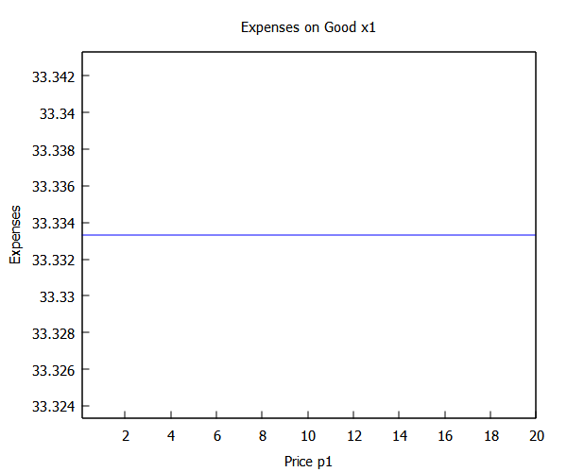
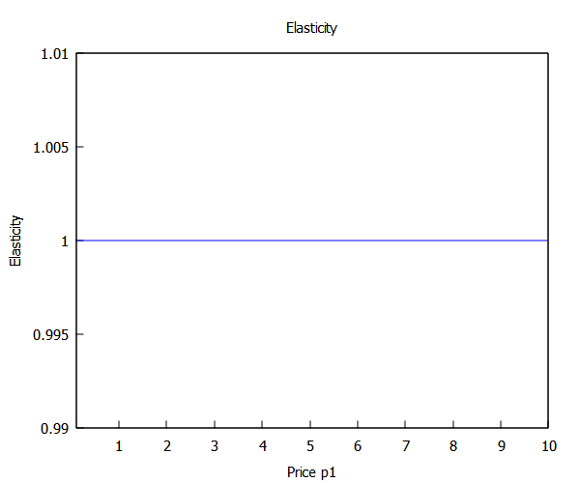
Properties of the demand function
  Price Elasticity: Demand functions are nonlinear to the price of the good itself. The price elasticity for x1 and x2 is constant equal to (-)1. This means that the % change in price is completely compensated by the % change in quantity. Expenditures on x1 and x2 do not depend on prices at all : /
kill(all); /* Clear all previous definitions and variables */
/* Load the draw package (only necessary if plotting is required) */
load(draw);
/* Assume positive values for variables and parameters */
assume(
x1 > 0, x2 > 0, /* Quantities of goods x1, x2 */
p1 > 0, p2 > 0, /* Prices of goods p1, p2 */
α > 0, α < 1, /* Preference parameter α for x1 */
β > 0, β < 1, /* Preference parameter β for x2 */
M > 0 /* Consumer's income */
);
/* Declare constants to ensure they are not treated as variables in Maxima */
declare(α, constant);
declare(β, constant);
/* Define demand functions for goods x1 and x2 based on income and prices */
x1 : (α * M) / ((β + α) * p1); /* Demand for x1 as a function of p1 */
x2 : (β * M) / ((β + α) * p2); /* Demand for x2 as a function of p2 */
/* Calculate the own-price elasticity of demand for x1 */
E_p : -diff(x1, p1, 1) * p1 / x1; /* Elasticity formula with respect to p1 */
/* Plot the elasticity of demand for x1 with respect to p1 */
draw2d(
title = "Elasticity",
xlabel = "Price p1",
ylabel = "Elasticity",
explicit(E_p, p1, 0.1, 10), /* Plot elasticity as a function of p1 */
color = green,
line_width = 2 );
kill(all); /* Clear all previous definitions and variables */
/* Load the draw package (only necessary if plotting is required) */
load(draw);
/* Declare constants for parameters */
M: 100; /* Consumer's income */
α: 0.3; /* Preference parameter α for x1 */
β: 0.6; /* Preference parameter β for x2 */
/* Assume positive values for variables and parameters */
assume( x1 > 0, p1 > 0); /* Quantity of good x1 and price of p1 */
/* Define the demand function for x1 based on income and price */
x1 : (α * M) / ((β + α) * p1); /* Demand for x1 as a function of p1 */
/* Define the expense function as Expenses = p1 * x1 */
Expenses : p1 * x1;
/* Plot the expense function over the range of p1 from 0.1 to 20 */
draw2d(
title = "Expenses on Good x1",
xlabel = "Price p1",
ylabel = "Expenses",
explicit(Expenses, p1, 0.1, 20), /* Plot Expenses as a function of p1 */
color = blue,
line_width = 2 );

Slide 21
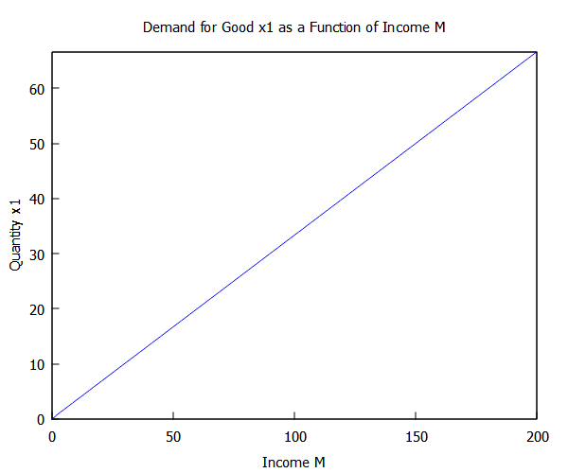
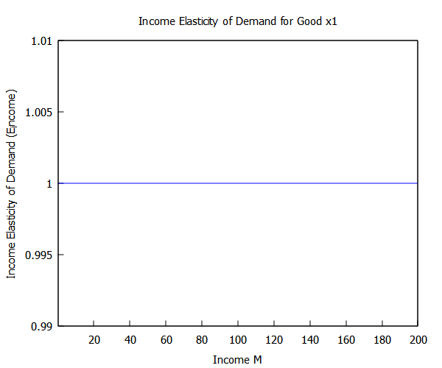
Properties of the demand function
The income elasticity for x1 and x2 is constant equal to 1. The proportion of spending on x1 and x2 is constant and independent of income. We always spend a constant amount of our budget on x1. [we earn 5000 or 500000 zlotys and on food (x1) we spend alpha% on durable goods beta%.
Only normal goods can be modeled, there is no possibility of modeling inferior goods.
kill(all); /* Clear all previous definitions and variables */
load(draw);/* Load the draw package (only necessary if plotting is required) */
/* Declare constants for parameters */
p1: 1; /* Price of good x1 */
p2: 1; /* Price of good x2 */
α: 0.3; /* Preference parameter α for x1 */
β: 0.6; /* Preference parameter β for x2 */
/* Assume positive values for variables */
assume(x1 > 0, M > 0); /* Quantity of good x1 and consumer's income */
/* Define the demand function for x1 as a function of M */
x1 : (α * M) / ((β + α) * p1); /* Demand for x1 as a function of income M */
/* Plot x1 as a function of M */
draw2d(
title = "Demand for Good x1 as a Function of Income M",
xlabel = "Income M",
ylabel = "Quantity x1",
explicit(x1, M, 0, 200), /* Plot x1 as a function of M over the range 0 to 200 */
color = blue,
line_width = 2);
kill(all); /* Clear all previous definitions and variables */ /* Load the draw package (only necessary if plotting is required) */ load(draw); /* Declare constants for parameters */ p1: 1; /* Price of good x1 */ α: 0.3; /* Preference parameter α for x1 */ β: 0.6; /* Preference parameter β for x2 */ /* Assume positive values for variables */ assume(x1 > 0, M > 0); /* Quantity of good x1 and consumer's income */ /* Define the demand function for x1 as a function of M */ x1 : (α * M) / ((β + α) * p1); /* Demand for x1 as a function of income M */ /* Calculate income elasticity of demand for x1 */ E_income : diff(x1, M) * M / x1; /* Simplify the expression for better readability */ E_income_simplified : ratsimp(E_income); /* Plot income elasticity of demand for x1 as a function of M */ draw2d( title = "Income Elasticity of Demand for Good x1", xlabel = "Income M", ylabel = "Income Elasticity of Demand (E_income)", explicit(E_income_simplified, M, 0.1, 200), /* Plot E_income as a function of M over the range 0.1 to 200 */ color = red, line_width = 2 );

Slide 22
Properties of the demand function
The property of Cross-Price Independence in demand functions means that the demand for one good, x1, does not depend on the price of another good, p2, and vice versa. In this setup, each good is treated as completely independent of the other in terms of pricing effects.
For our demand function, cross-price elasticity is zero. This setup implies that x1 and x2 are neither substitutes nor complements. In reality, true cross-price independence is rare, as most goods are influenced by the prices of related goods. Thus, while cross-price independence simplifies modeling, it may not reflect real-world consumer behavior for goods with interdependencies.

Slide 23
Play with the model
Traditional textbook microeconomic theory provides a foundational understanding of the mechanisms that influence demand and outlines the general properties of demand functions. Orthodox theory emphasize internal validity, but their external validity is often questioned. While numerous studies have been based on this framework, many are now considered somewhat outdated. Exploring these studies can offer valuable insights into the history of economic thought.
In the following section, I will discuss potential extensions of the theory that facilitate integration with empirical research, moving beyond the traditional Arrow-Debreu framework. We will begin by examining Becker's random demand hypothesis.

Slide 24
Becker's hypothesis of random demand
In his 1962 paper, Gary Becker introduced a model of random consumer behavior to examine the implications of non-rational decision-making on market demand. He proposed that if consumers select goods randomly, subject to their budget constraints, the aggregate market demand could still exhibit properties similar to those predicted by traditional rational choice theory. Specifically, Becker demonstrated that even with random individual choices, the market demand curve could remain downward-sloping, indicating that total demand decreases as prices increase. This insight suggests that certain market behaviors traditionally attributed to rational decision-making might also emerge from random consumer actions.
[https://eprints.lse.ac.uk/27001/1/random_behaviour_%28LSERO%29.pdf]

Slide 25
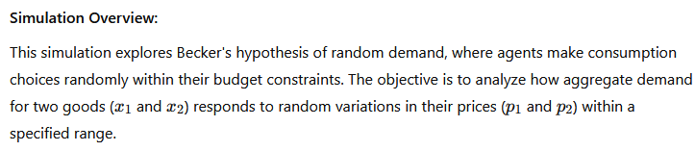
Becker's hypothesis of random demand

Slide 26
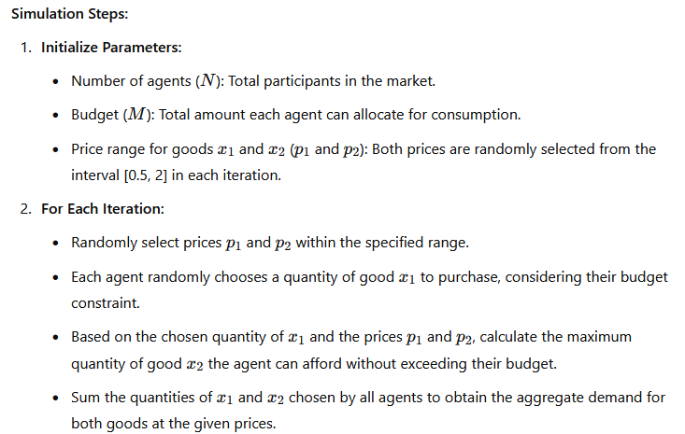
Preparing simulation – ZI-C Zero inteligents agents with constrain
#R
# Set initial parameters
N <- 1000 # Number of agents
M <- 100 # Budget for each agent
iterations <- 100 # Number of iterations for the simulation
price_range <- c(0.5, 2) # Range for prices p1 and p2
# Vectors to store results
aggregate_demand_x1 <- numeric(iterations)
aggregate_demand_x2 <- numeric(iterations)
p1_values <- numeric(iterations)
p2_values <- numeric(iterations)
# Function to generate random choices within budget constraint
generate_choices <- function(p1, p2, M) {
# Randomly select quantity of x1 within feasible range
x1 <- runif(1, 0, M / p1)
# Calculate corresponding quantity of x2 to satisfy budget constraint
x2 <- (M - p1 * x1) / p2
return(c(x1, x2))
}
# Simulation loop over specified number of iterations
for (i in 1:iterations) {
# Randomly select prices p1 and p2 within the specified range
p1 <- runif(1, price_range[1], price_range[2])
p2 <- runif(1, price_range[1], price_range[2])
# Store the selected prices
p1_values[i] <- p1
p2_values[i] <- p2
total_x1 <- 0
total_x2 <- 0
# Each agent makes a random choice
for (j in 1:N) {
choices <- generate_choices(p1, p2, M)
total_x1 <- total_x1 + choices[1]
total_x2 <- total_x2 + choices[2]
}
# Store aggregate demand for current prices
aggregate_demand_x1[i] <- total_x1
aggregate_demand_x2[i] <- total_x2
}
# Plot aggregate demand for x1 as a function of price of x1
plot(p1_values, aggregate_demand_x1, col = "blue",
xlab = "Price of good x1 (p1)", ylab = "Aggregate demand for x1",
main = "Aggregate Demand for x1 vs. Price of Good x1")
# Plot aggregate demand for x2 as a function of price of x2
plot(p2_values, aggregate_demand_x2, col = "red",
xlab = "Price of good x2 (p2)", ylab = "Aggregate demand for x2",
main = "Aggregate Demand for x2 vs. Price of Good x2")

Slide 27
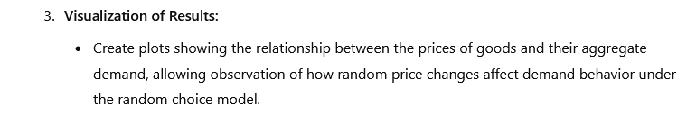
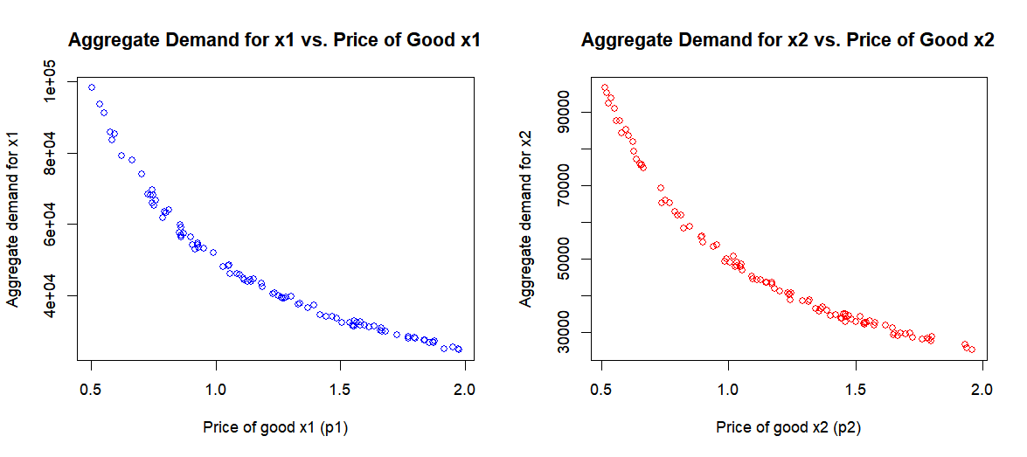
Preparing simulation – Zero inteligents agents with constrain ZI-C

Slide 28
ZI-C agents
Zero-intelligence (ZI) modeling is an approach in economics and finance that assumes market participants make decisions randomly, without strategic thinking or optimization. The main areas of application are "stress tests" of institutional arrangements, especially markets.
  Analyzing market efficiency: Studies have shown that markets with ZI agents can achieve high allocative efficiency, suggesting that market structure can compensate for the lack of rationality among participants.
  Examining the impact of market institutions: ZI models allow for assessing the extent to which market mechanisms affect outcomes, independent of the behavior of individual agents.
  Comparison with more advanced models: They serve as a benchmark for assessing how the introduction of intelligence and strategy affects market outcomes.

Slide 29

Veblen’s goods
If you're interested in anthropology and its intersection with economics, I recommend starting with The Theory of the Leisure Class by Thorstein Veblen. This classic work explores the social dynamics behind consumption and status, making it a perfect winter read.
However, you might be surprised by how frequently deviations from the law of demand occur, yet go largely unaddressed in traditional microeconomic theory. Anthropologists have long noted behaviors like fashion trends, snobbery, and crowd-following, initially viewed as market anomalies. Today, these behaviors have become core drivers of consumer behavior.

Slide 30
Veblen’s goods
Behavioral economist Harvey Leibenstein extended Veblen’s ideas to explain how consumer demand often contradicts the classic law of demand. He identified three main effects that illustrate this divergence:
The Bandwagon Effect: This effect occurs when the demand for a product increases because others are also buying it. People often feel compelled to join in, aiming to conform with social groups they admire or to appear fashionable. This effect is now often referred to as a “network effect,” where the popularity of a product or service grows as more people use it, amplifying its appeal. Think of social media platforms—who doesn’t have a Facebook or Instagram account these days?

Slide 31
Veblen’s goods
The Snob Effect: In contrast to the bandwagon effect, the snob effect describes a situation where demand decreases as a product becomes more widely consumed. Here, the motivation is to stand out, to be part of an exclusive circle, and to separate oneself from the "common herd." An example might be driving a rare or unusual car model, something that doesn’t blend into mainstream choices. For instance, who chooses a Fiat Multipla?
The Veblen Effect: This effect describes a form of conspicuous consumption, where the demand for certain goods increases because they have a higher price. This contradicts the law of demand, which states that demand typically decreases as price rises. The Veblen effect highlights how people use luxury goods to display social status through visible, high-cost purchases. A well-known example is the iPhone, where higher prices may even add to its appeal as a status symbol.
The distinction between these effects is worth noting: while the snob bandwagon effects are related to others' consumption behavior, the Veblen effect relates directly to the price of the product itself.

Slide 32
Veblen’s goods
These effects underscore that consumer behavior is complex and often shaped by social factors beyond mere utility or cost considerations. Today’s economic models, particularly in behavioral economics, increasingly recognize these deviations, yet they still challenge traditional microeconomic assumptions.
Translating anthropological and psychological perspectives into economic modelling presents significant challenges. Evolutionary economics addresses these challenges by examining the dynamics of demand changes through the lens of social class transitions, as conceptualized by Marx and Veblen. This field often employs Agent-Based Computational Economics (ACE) models to simulate and analyze complex economic behaviours ( we will discuss it later).
Below is a summary of the main assumptions for modeling the demand side of the economy [ based on the article: https://link.springer.com/article/10.1007/s00191-018-0592-2]

Slide 33
Veblen’s goods
Veblen’s model suggests that consumer preferences are driven by social rank, where property ownership equates to status. The leisure class demonstrates wealth through public consumption, while the working class emulates but never fully matches this display. This concept of “social distinction” persists beyond 19th-century America, as sociologist Pierre Bourdieu showed that consumer tastes are socially mediated, contributing to class-based cultural dominance and reinforcing economic inequality.
Key behavioral effects are :
Bandwagon Effect - Increased demand due to others’ consumption.
Snob Effect - Decreased demand as more people consume the product, highlighting exclusivity.
Veblen Effect - Demand increases with price, reflecting status-seeking consumption.

Slide 34
Veblen’s goods
The model diverges from traditional approaches by adapting dynamically to consumer needs and wants, shaped by loyalty to firms and aspirations for status. Households adjust vendor choices based on price and reputation, showing bounded rationality. Class distinctions affect these preferences, with capitalists displaying higher savings and different consumption patterns than workers. Social dynamics, like imitation and signaling through consumption, guide household choices.
The analysis integrates both Marxian and Veblenian class theories, illustrating the influence of social structures on economic behaviors. While the model accounts for class mobility (e.g., workers becoming capitalists), it assumes lag in social recognition of these changes. The model aligns with Erik Wright’s class analysis frameworks, recognizing Marxian, Weberian, and situational class power dynamics, all influencing consumer preferences in capitalist societies.

Slide 35
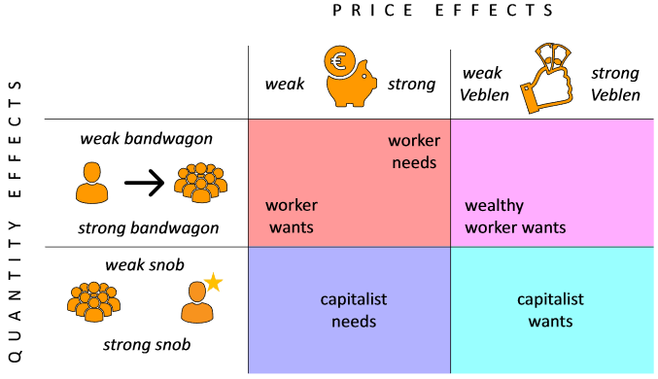
Veblen’s goods
The chart presents a framework for understanding consumer behavior based on social class distinctions and two main effects: price effects (horizontal axis) and quantity effects (vertical axis). It categorizes preferences into four quadrants, each representing a different class segment and its tendencies in consumption:

Slide 36
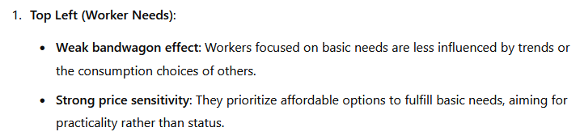
Veblen’s goods

Slide 37
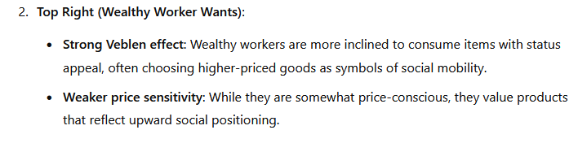
Veblen’s goods

Slide 38
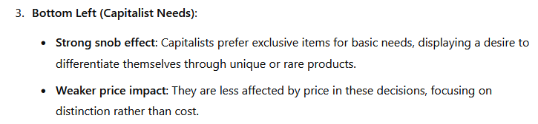
Becker's hypothesis of random demand

Slide 39
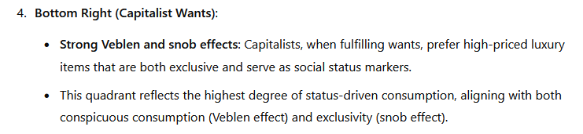
Veblen’s goods

Slide 40
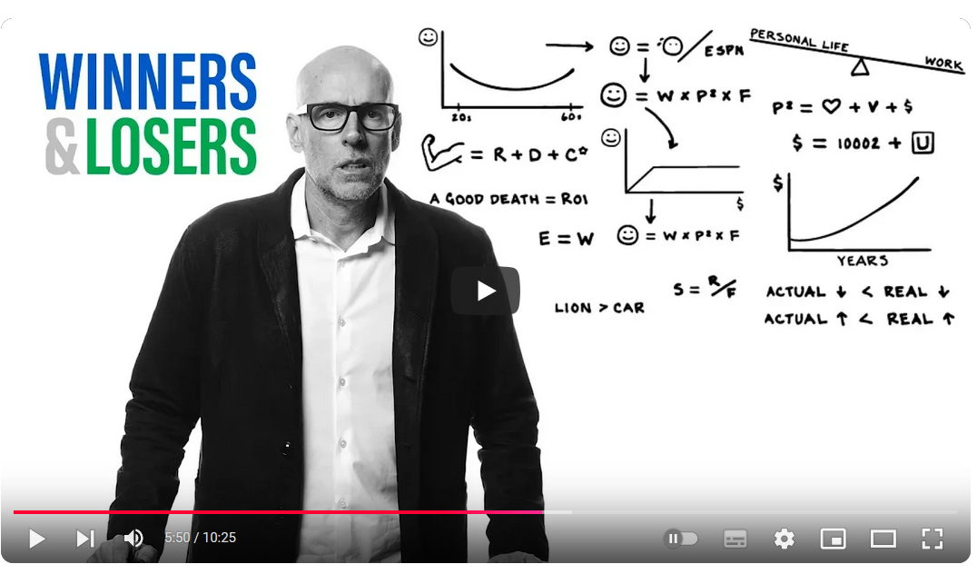

Veblen’s goods
This approach is challenging to model (though not impossible) due to the chaotic nature of social change dynamics and the lack of a rationality assumption. Unfortunately, it is often stigmatized as lefties.
However, it’s essential to recognize that our behavior is sometimes influenced by forces we are not consciously aware of. Interestingly, even Scott Galloway, one of the most pro-capitalist economists, and marketing guru Rory Sutherland have offered life advice grounded in this perspective.
https://www.youtube.com/watch?v=qMW6xgPgY4s&t=350s
https://www.youtube.com/watch?v=Hz3RWxJck68 [~ 24 min ]

Slide 41
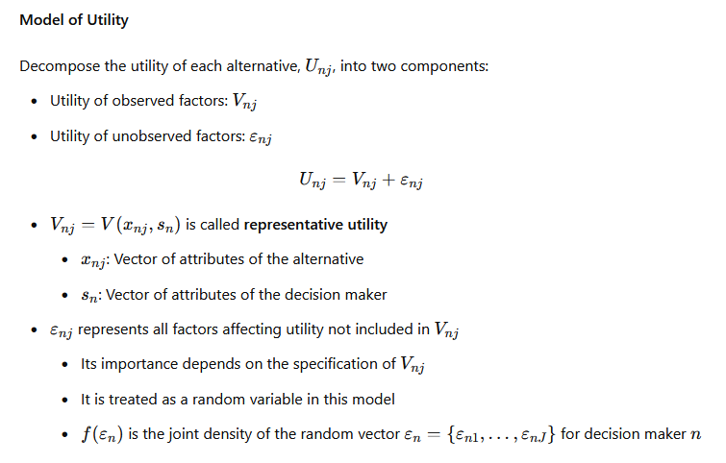
Random Utility Model
The Random Utility Model links economic theory and research. While it keeps the assumption of rationality, it accepts that random factors influence choices. The assumption of homogeneity, however, is relaxed: consumers have unique characteristics (attributes), and products are not homogeneous; they are considered "vectors of characteristics."
When consumers buy one product over another, they reveal their preferences in a binary choice (buy/not buy, 0-1). In the model's terms, for a person with given characteristics, the probability of purchasing a particular product (vector of characteristics) is the highest.
Microeconometrics aims to estimate models that identify key product and consumer characteristics influencing purchasing decisions. These models are parametric.
https://www.youtube.com/watch?v=lMNXvI8IK20

Slide 42
Choice Experiment
The choice experiment is a microeconomic theory-driven approach to developing surveys to estimate consumers' WTP - Willingness to Pay. The method can be used to value markets and non-market commodities [value a new flat or how much is worth a beautiful view from the window]. This method is helpful in studies of new products, services, or price policies where traditional market data are unavailable.
This approach involves presenting respondents with sets of alternative options, each characterized by various attributes and levels of these attributes. Participants select their preferred option from each set, enabling researchers to:
  Identify critical factors influencing consumer decisions.
  Estimate the value assigned to specific characteristics of products or services.
  Model market behaviours and predict responses to changes in offerings or pricing policies.

Slide 43
Choice Experiment
Examples of Valuing Market and Non-Market Goods Using Choice Experiments
Market Goods:
Automobiles: Evaluating preferences for fuel efficiency and safety features.
Smartphones: Assessing the importance of battery life and camera quality.
Food Products: Determining the value placed on organic labels and local sourcing.
Travel Packages: Understanding preferences for destination attributes and pricing.
Non-Market Goods:
Environmental Conservation: Estimating willingness to pay (WTP) for preserving natural habitats.
Public Health Initiatives: Evaluate support for vaccination and prevention programs, and assessing the value of human life (will be discused).
Cultural Heritage: Valuing historical sites.
Urban Green Spaces: Estimating WTP for natural resources in a city, determining the value of a living tree, and assessing the importance of parks and recreational areas.
Our faculty has several world-class specialists in discrete choice experiment/ random utility methods applied to ecological valuation. Professors: Anna Bartczak, Mikołaj Czajkowski, Marek Geiergiczny, ....

Slide 44
Our
Economic models and theories provide insights into estimating demand, particularly consumer willingness to pay (WTP). As a data scientist, you may be tasked with this analysis. It's essential to understand the terminology and consider heterogeneity and treat:
Product as a vectors of characteristics: View products as collections of attributes [aligning with Random Utility and choice experiment models].
Consumers are not homogenius: Recognize consumers as individuals with unique socio-economic and psychological characteristics [as emphasized in Random Utility and choice experiment models].
Environmental Influences: Assess how factors such as social, cultural, and class contexts impact consumption behawior [ drawing from social psychology and concepts like Veblen goods].

Slide 45
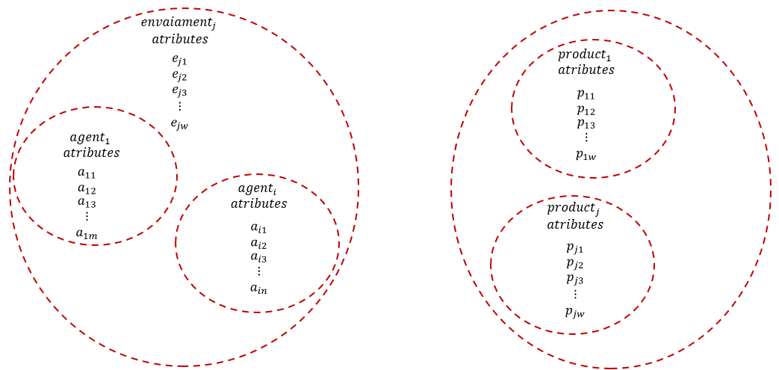
Your goal as DS?
Your goal will be to define demand in one of the following ways:
Binary Choice (Bought/Didn't Buy) → Classification models
Willingness to Pay (WTP) and Empirical Demand Functions
Instead of using a parametric model (econometrics), you will employ uninterpreted forecasting models. However, you must remain aware of the factors that influence demand and how these factors can shape demand characteristics.

Slide 46
My goal as DS?
Our last experiment is a very primitive way of obtaining such information. Of course, no one gives their WTP in real life, but you will reveal it yourself through your behavior. You generate a lot of data to estimate these values. Be aware ☺
My questions were intended to determine WTP of three products and they gave information about your attributes: working, not working / being transported to the UW / how and what type of consumption you follow / i.e. the influence of the cultural and social environment.
In December, I will use the obtained WTPs to show how companies create pricing strategies having an approximate empirical demand function. We will start with a simple price-quantity relationship.

Slide 47
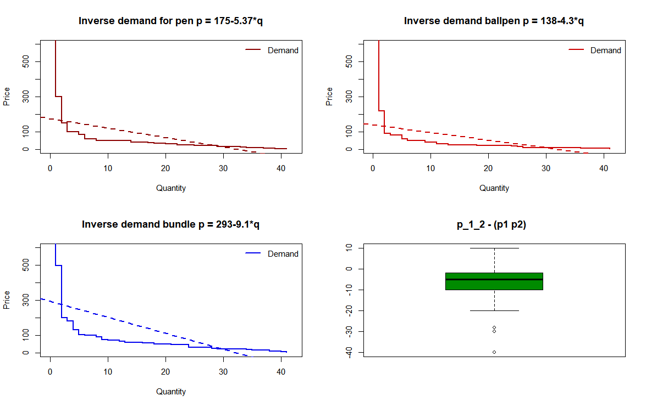
My goal as DS?
What do you think about these demand functions?
How will a perfectly competitive market set the price?
What price will a monopolist set?
How can we use this information to create an appropriate pricing strategy?
How to apply price discrimination based on your revealed attributes?
Sell separately or in sets?
Or maybe introduce an auction sales system?
All about it on December and January.

